Slide 1



Present-A Better Way to Presentation
2

Slide 2




Team details
Atharva Kamble
Govind Mudavadkar
Gaurav Sinha
3

Slide 3
Problem Statement:-
Problem:
Presentations are tedious in general
Need for creating an ease of presentation workflow
Solution:
We try to aim at making the user workflow in the entire process as quick as possible
‹#›

Slide 4

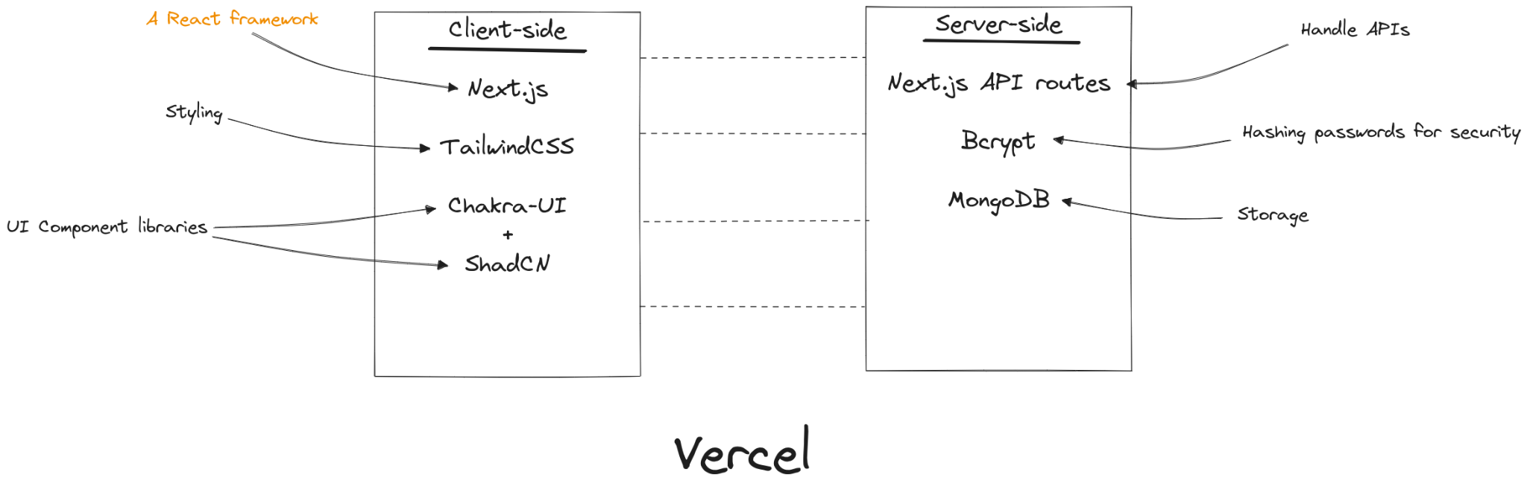
Architecture of Project
‹#›

Slide 5
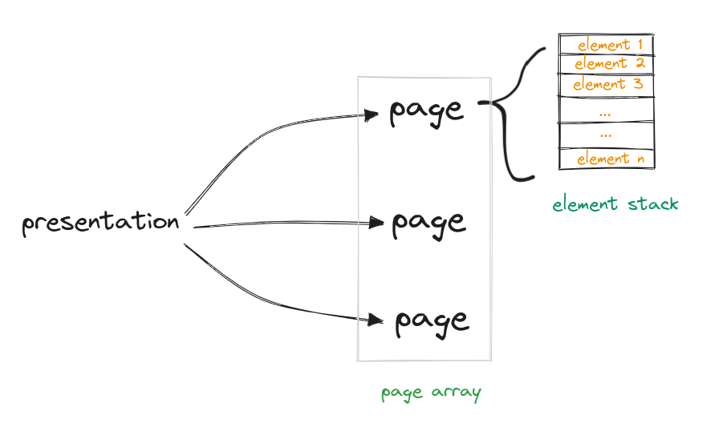
How are we rendering the Presentation:
‹#›

Slide 6





Technologies Used
Client side
VS code
React Js
Typescript
Github
8

Slide 7



Technologies Used
Back End and Database
Next Js
Node Js
Mongo DB
App Hosting: Vercel
11

Slide 8
Agile Methodology
The project was broken down into smaller, more manageable stories that were completed individually.
Following weekly sprints to complete selective stories.
Took a period of 4 sprints (1 month)

Slide 9

Challenges faced
Deployment (Vercel was the way to go!)
Marking down tasks for the week
Estimating time for a particular task
1515

Slide 10
Future aspects
We have following ideas for upscaling the project :-
Add markdown based editing in the text
Give user freedom to upload their own files
Collaborate multiple users in a single PPT just like Google slide
More ideas are welcome !

Slide 11
Thank You
We’ll now move to the demo

